Slide 1
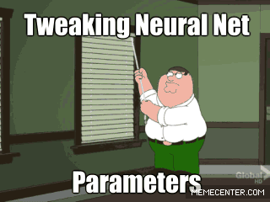
Convolutional neural networks
And other cool stuff if we have enough time

Slide 2
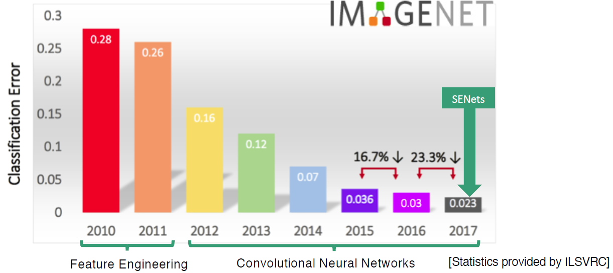
What are SENets?

Slide 3
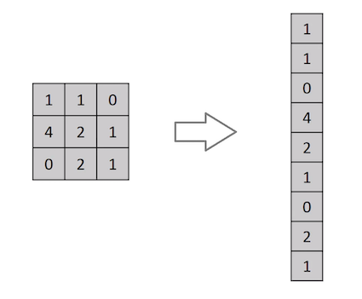
Convolutional Neural Network (CNN)
Until now: Flatten image
Why not?

Slide 4

Convolutional Neural Network (CNN)

Slide 5

Convolutional Neural Network (CNN)
kernels

Slide 6

Convolutional Neural Network (CNN)
stride
padding

Slide 7

Convolutional Neural Network (CNN)
pooling

Slide 8

Convolutional Neural Network (CNN)
Pooling
Good resource

Slide 9
Keras example

Slide 10
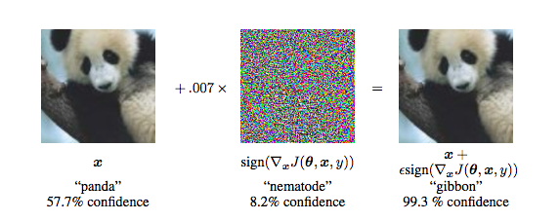
Adversarial examples

Slide 11
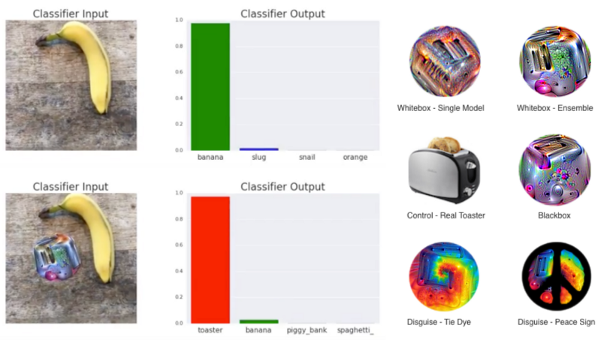
Adversarial examples
Power of invisability

Slide 12
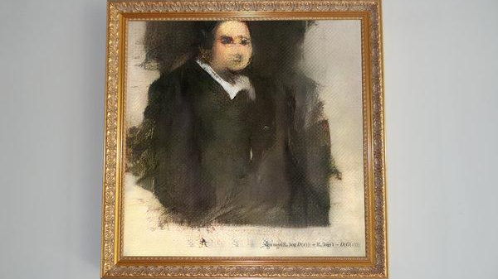
GAN ART
Full story

Slide 13
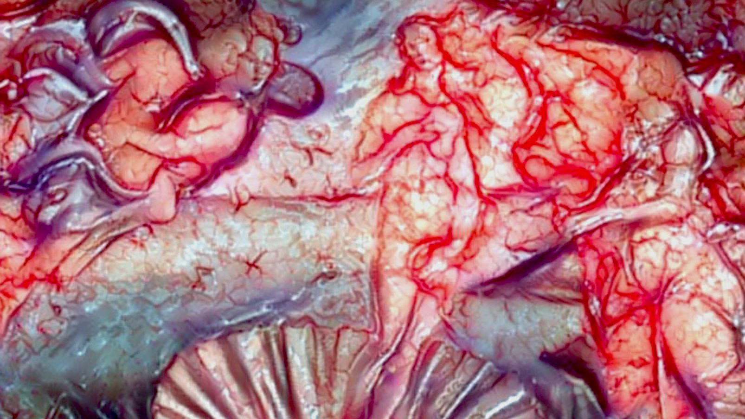
GAN ART
Algorithmic horror

Slide 14

GAN ART
Style transfer in video

Slide 15
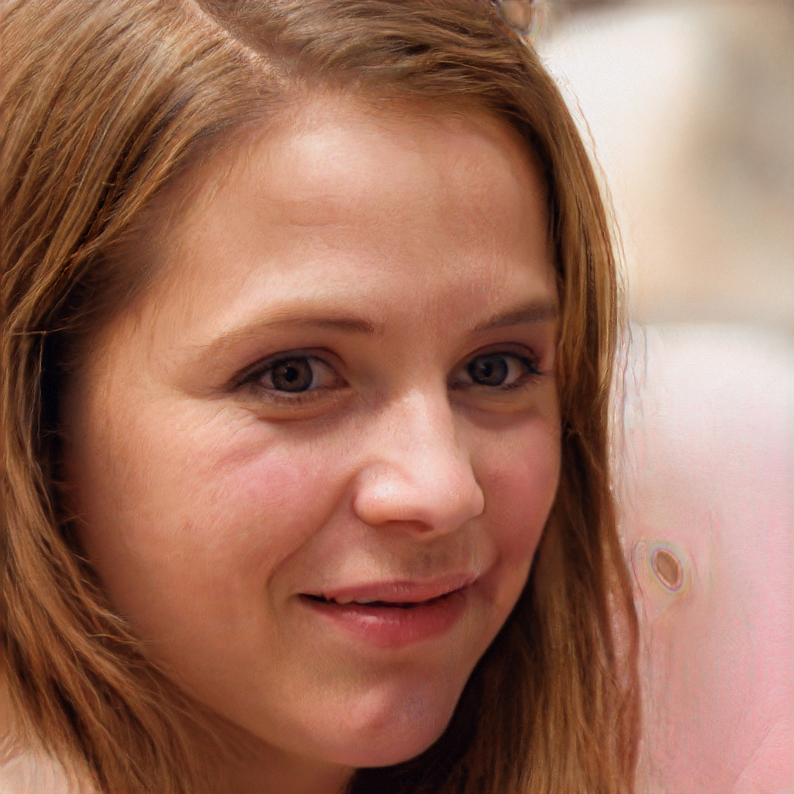
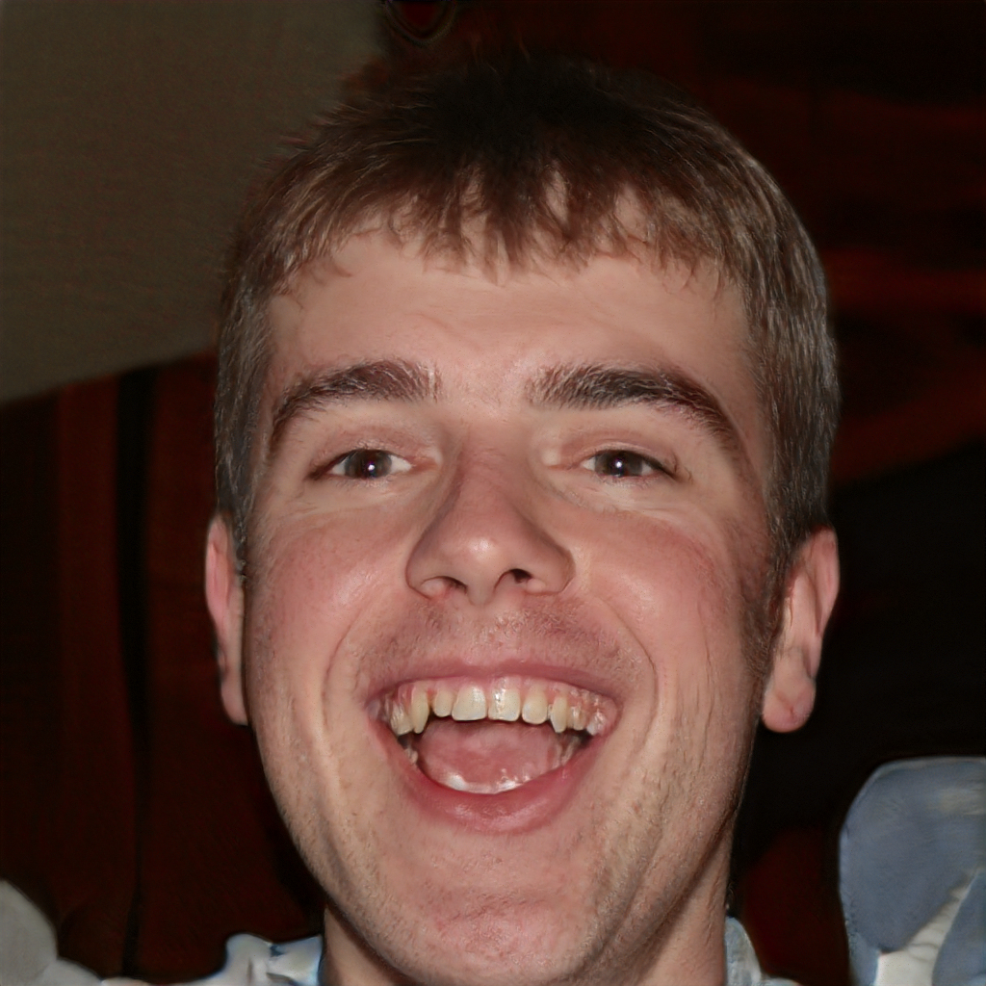
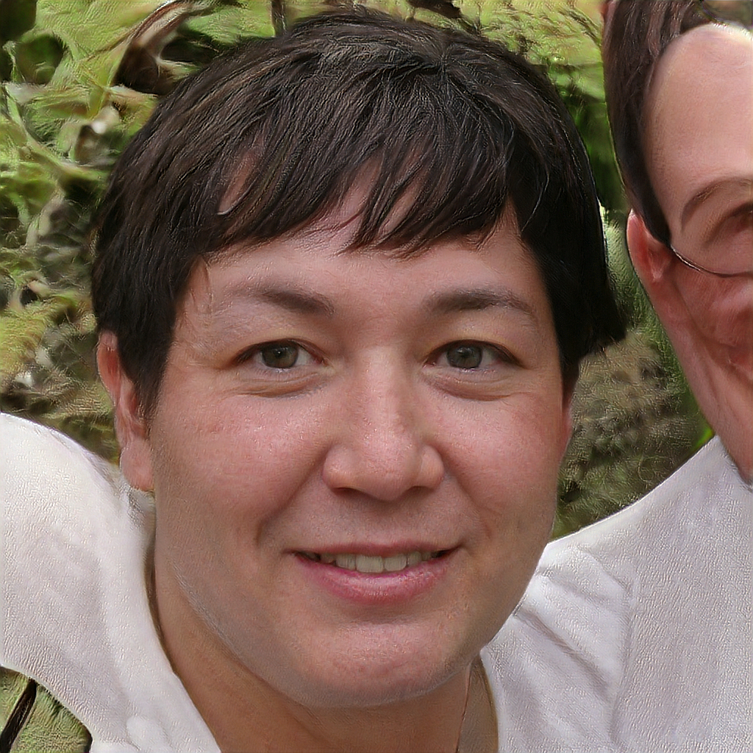
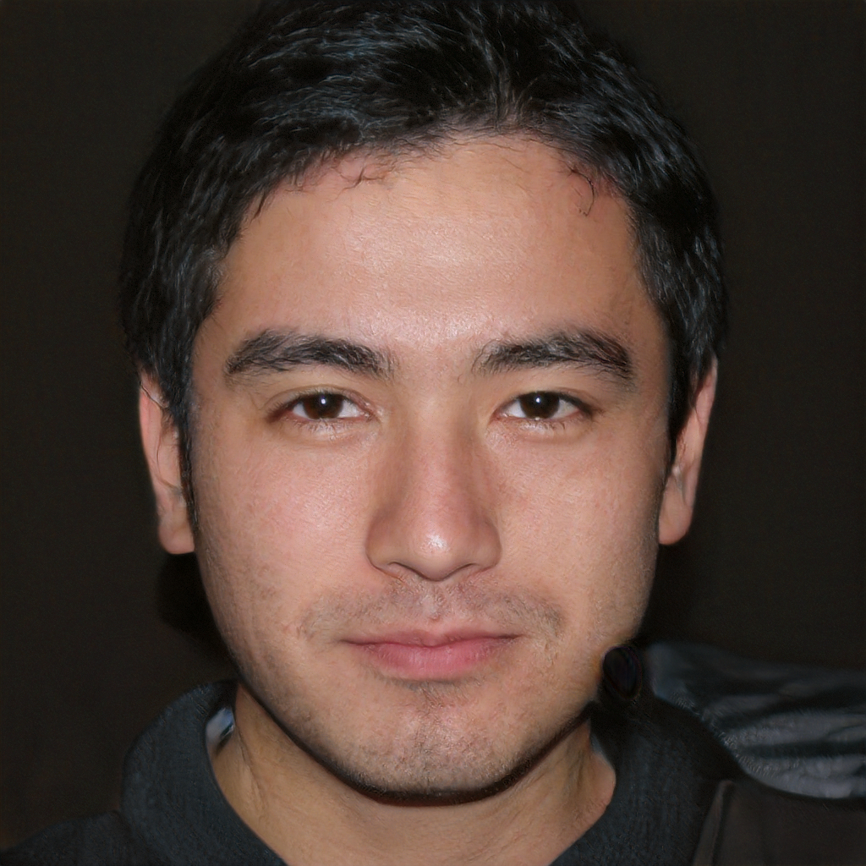
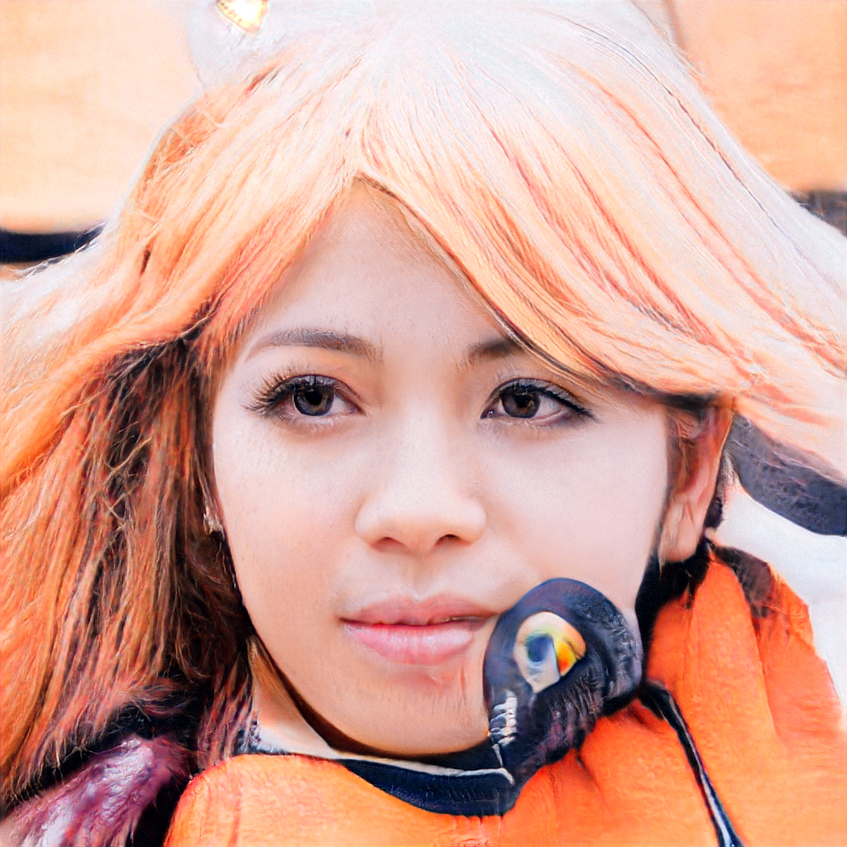

GAN ART
this person does not exist

Slide 16
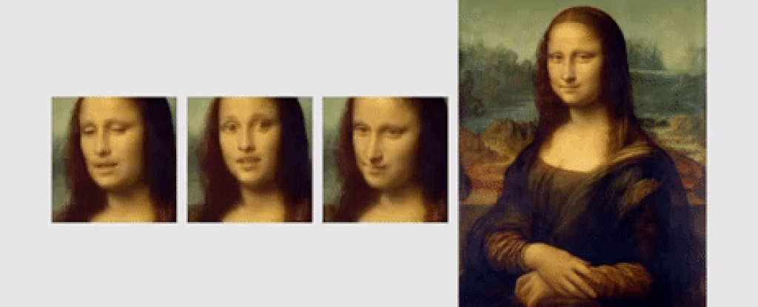
GAN ART
deepfakes

Slide 17

Recurrent Neural Networks (RNN)

Slide 18

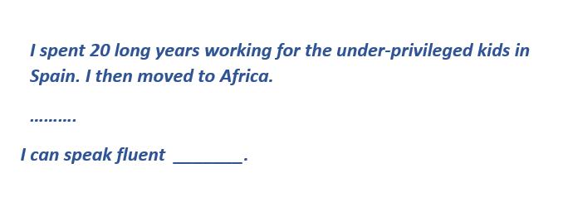
Recurrent Neural Networks (RNN)

